Slide 1
Low SNR Speech Enhancement
Edward Chan
Timothy Cabrera
Group 58

Slide 2
CONTENTS
Our Motivation
The Problem
Project Goals
Background Theory
Implementation
Dataset
Results of the CNN Classification model
Results of the GAN Speech Estimation Model
Speech Enhancement using the Proposed Method
Evaluation Results
Future Considerations

Slide 3

Our motivation
Signal-to-noise ratio (SNR).
Measures the signal power relative to the noise power.
Low SNR → Background noise signal >> Speakers voice signal.
Example: Friend at a concert.
High SNR
Low SNR

Slide 4
The problem
For effective low SNR speech enhancement, it is often the case that many microphones are needed.
However, many common devices do not have access to such configurations.
We aim to improve on single-channel methods.
However, this task is still challenging for most single-channel methods.

Slide 5
Project goals
Our key goals were to:
Create a learning machine that could estimate speech and noise based on an observed mixture.
Create a classifier that distinguishes between signal-to-noise ratios (SNR).
Enhancing speech signal with an SNR level <0dB should be intelligible.

Slide 6
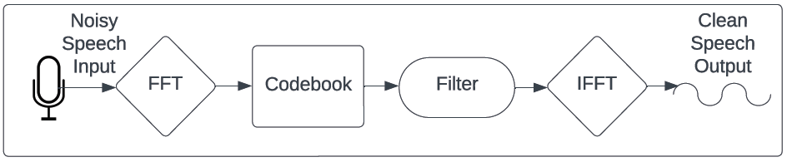
Background Theory
To enhance speech, noise is typically estimated and removed from speech.
However, with low SNR signals, the power of speech is so low that noise or speech estimation errors will affect intelligibility.
Our method is based on the well-known method of codebooks.
Codebooks are a collection of noise and speech candidates which number in the thousands. The most well-suited candidate is chosen as an input to a filter.

Slide 7
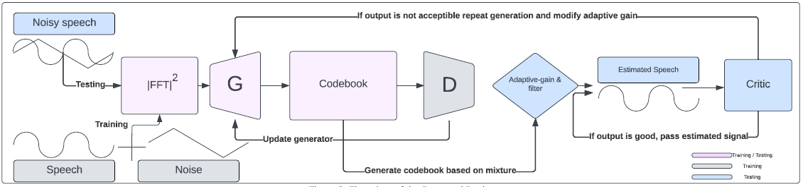
Implementation
The flow chart of our proposed design displays both the method to train and test the overall speech enhancement method
Trained using a generative adversarial network (GAN) designed to take the mixture power spectral density to generate a codebook based on the observed noisy speech mixture to estimate the noise.
Testing the design using the GAN to predict the noise from a noisy mixture and keep estimating until a high SNR level is achieved using a classification model (the critic) to distinguish between low and high SNR.

Slide 8
Datasets
Speech dataset (CSTR VCTK Corpus) → English Multi-speaker Corpus for CSTK Voice Cloning Toolkit from the University of Edinburgh (48kHz)
106 English speakers with 400 sentences each
Noise dataset (DEMAND) → Diverse Environment Multichannel Acoustic Noise Database (16 and 48kHz)
17 Noise environment
[1] Veaux, C., Yamagishi, J., & King, S. (2013). The voice bank corpus: Design, collection and data analysis of a large regional accent speech database. 2013 International Conference Oriental COCOSDA Held Jointly with 2013 Conference on Asian Spoken Language Research and Evaluation, O-COCOSDA/CASLRE 2013. https://doi.org/10.1109/ICSDA.2013.6709856
[2] Thiemann, J., Ito, N., & Vincent, E. (2013). The Diverse Environments Multi-Channel Acoustic Noise Database (DEMAND): A database of multichannel environmental noise recordings. Proceedings of Meetings on Acoustics, 19, 1–6. https://doi.org/10.1121/1.4799597

Slide 9
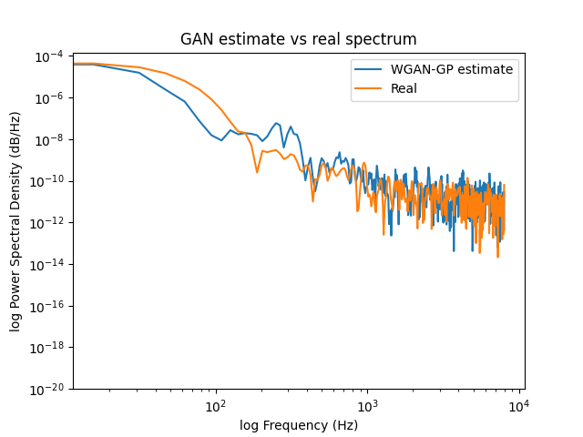
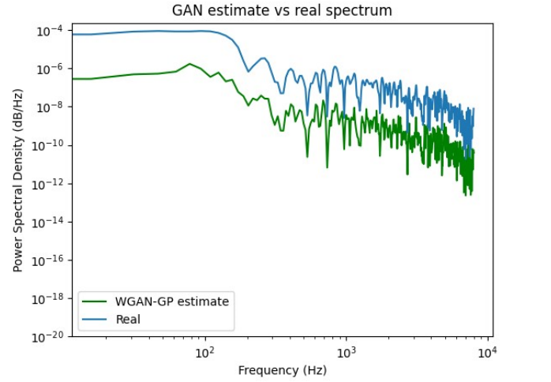
Generative adversarial networks & results.
Generative adversarial networks (GANs) have been extensively used in image generation from low dimensional inputs.
Composed of a generator and discriminator neural network. The discriminator learns to differentiate between fake and real data. The generator uses the feedback of the discriminator to generate fake data that is indistinguishable from real.
In this project, a codebook is generated instead of an image based on the noisy speech.
Results show that it can estimate noise very accurately but cannot estimate speech very well.
Speech estimation failure
Noise estimation success

Slide 10
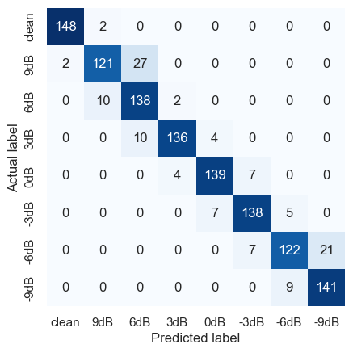
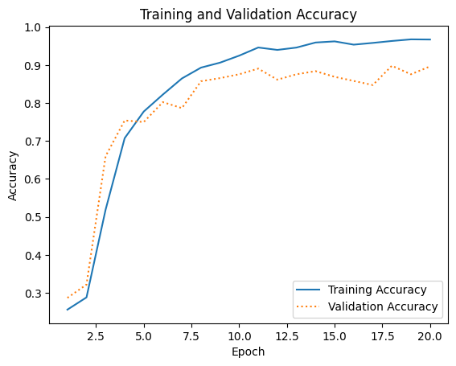
Results of the CNN classification model
Convolutional neural networks (CNN) are generally used for image classification
We used the CNN to classify spectrogram SNR levels as clean at 9, 6 and 3dB
While noisy SNR levels at 0, -3, -6 and -9dB
From the Validation accuracy, we can see that it reached approximately 90%, and testing validates this.

Slide 11
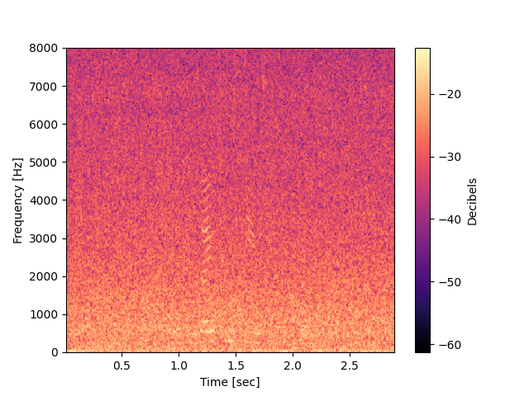
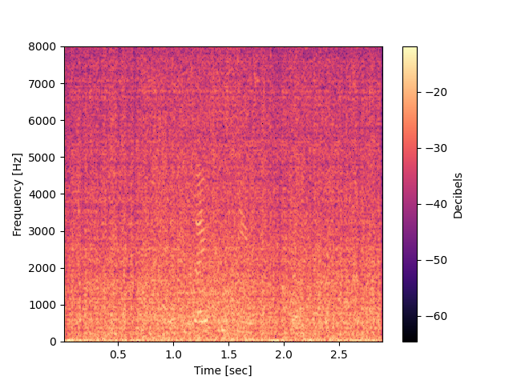
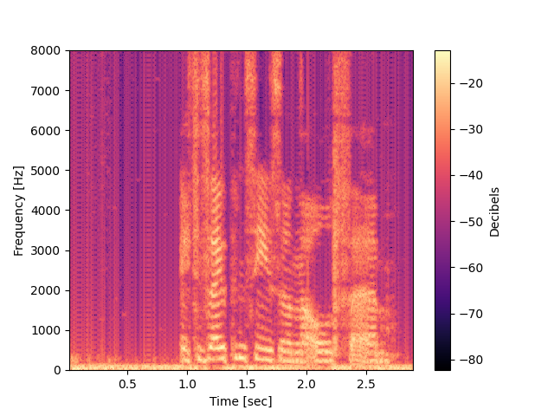
Speech enhancement using the proposed method
Original
Proposed
Semi-optimal

Slide 12
Evaluation results with Signal-Distortion Ratio
SDR | -3 | -6 | -9
Orignal | N/A | N/A | N/A
Proposed | -12.826 | -12.810 | -12.669
Semi-optimal | -3.420 | -5.345 | -7.674
Measures speech distortion, a higher score indicates better enhancement of the original signal.

Slide 13
Evaluation results with Perceptual Evaluation of Speech Quality
PESQ | -3 | -6 | -9
Orignal | N/A | N/A | N/A
Proposed | 1.025 | 1.025 | 1.023
Semi-optimal | 1.047 | 1.042 | 1.032
Measures speech quality: A higher score indicates better quality of speech.

Slide 14
Evaluation results with Short-Time Objective Intelligibility
STOI | -3 | -6 | -9
Orignal | N/A | N/A | N/A
Proposed | 0.3707 | 0.3707 | 0.3707
Semi-optimal | 0.552 | 0.532 | 0.512
Measures speech intelligibility, a higher percentage indicates a better extent to which the signal can be understood.

Slide 15
Future Considerations
The speech estimator integration into the proposed model to improve intelligibility at low SNR mixtures.
Refining the classification model by including an unintelligibility class
Extending the training dataset with realistic and simulated noise data
Improved computational power for longer training durations to enhance the model’s performance and capabilities.

Slide 16
STFT parameters & Training parameters
For reconstructability we present the following parameters:
WAV files are downsampled to 16Khz
Anti-aliasing filter: Recursive (IIR) Butterworth low-pass filter
Bit-depth = 16
Codec = PCM 16
Window size: 512 (32ms)
Hopsize/overlapping samples = 128/384 (75% overlap)
NFFT:1024
Zero-padding
Window type: Hann/Hanning
Reconstruction method: Overlap-add (75% overlap)
GAN type: Wasserstein GAN-Gradient Penalty (WGAN-GP)
Architecture: Fully connected-layers (Dense).
Batch size: 64
Epochs: 4
CNN type: Classification model
Utterances 1500 with 8 different SNR levels
80/10/10 Training, validation and testing
Batch size: 10
Epoch: 20

